Slide 1
Time Management
Slides derived from Time Management talk at
Carnegie Mellon University

Slide 2
Clarify your goals and achieve them
Handle people and projects that waste your time
Be involved in better delegation
Work more efficiently with your boss/advisor
Learn specific skills and tools to save you time
Overcome stress and procrastination
= really important point

Slide 3
Remember that time is money
Ben Franklin, 1748
Advice to a young tradesman

Slide 4
Outline
Why is Time Management Important?
Goals, Priorities, and Planning
TO DO Lists
Desks, paperwork, telephones
Scheduling Yourself
Delegation
Meetings
Technology
General Advice

Slide 5
Why Time Management is Important
“The Time Famine”
starving for more time to do everything we need to do
Bad time management = stress
This is life advice

Slide 6
The Problem is Severe
By some estimates, people waste about 2 hours per day. Signs of time wasting:
Messy desk and cluttered (or no) files
Can’t find things
Miss appointments, need to reschedule them late and/or unprepared for meetings
Volunteer to do things other people should do
Tired/unable to concentrate

Slide 7
Hear me Now, Believe me Later
Being successful doesn’t make you manage your time well.
Managing your time well makes you successful.

Slide 8
Goals, Priorities, and Planning
Why am I doing this?
What is the goal?
Why will I succeed?
What happens if I chose not to do it?

Slide 9
The 80/20 Rule
Critical few and the trivial many
Having the courage of your convictions
Good judgment comes from experience
Experiences comes from bad judgment

Slide 10
Planning
Failing to plan is planning to fail
Plan Each Day, Each Week, Each Semester
You can always change your plan, but only once you have one!
Make manageable, concrete task lists and take one step after another
Randy Pausch, The Last Lecture

Slide 11
TO Do Lists
Break things down into small steps
Like a child cleaning his/her room
Do the ugliest thing first

Slide 12
The four-quadrant TO DO List
Due Soon
Not Due Soon
1 | 2
3 | 4
Important
Not
Important
Tempted to go from 1 to 3, but go to 2 instead

Slide 13
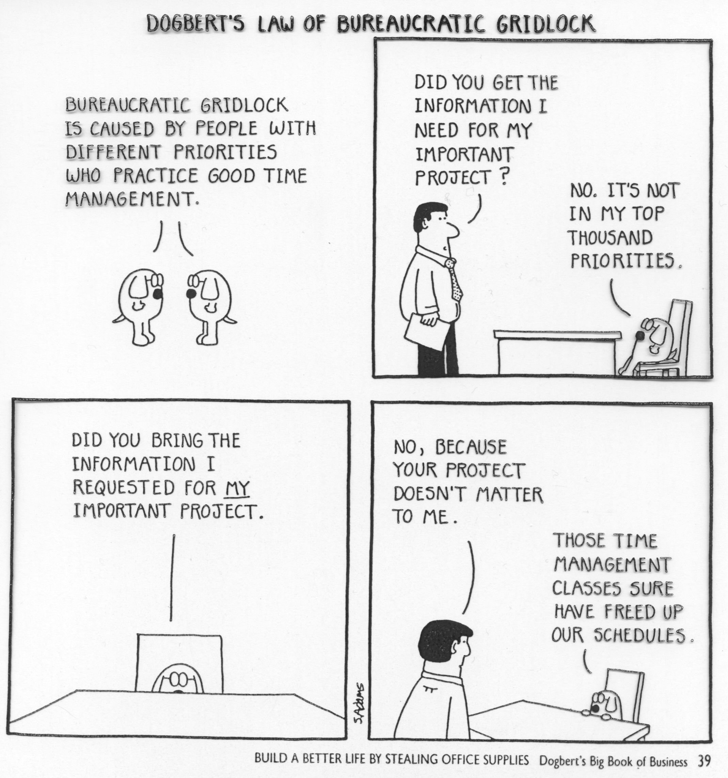

Slide 14
Paperwork
Clutter is death; it leads to thrashing. Keep desk clear: focus on one thing at a time
A good file system is essential
Touch each piece of paper once
Touch each piece of email once; your inbox is not your TODO list

Slide 15
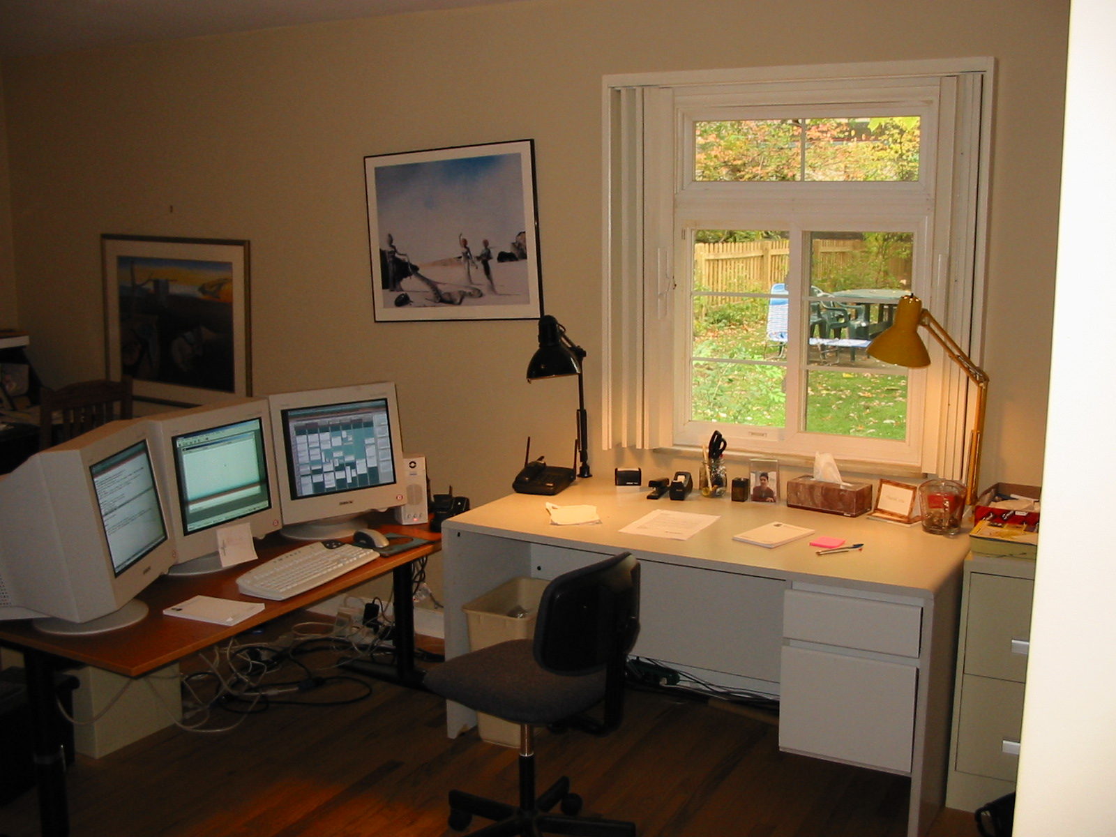
My Desk

Slide 16
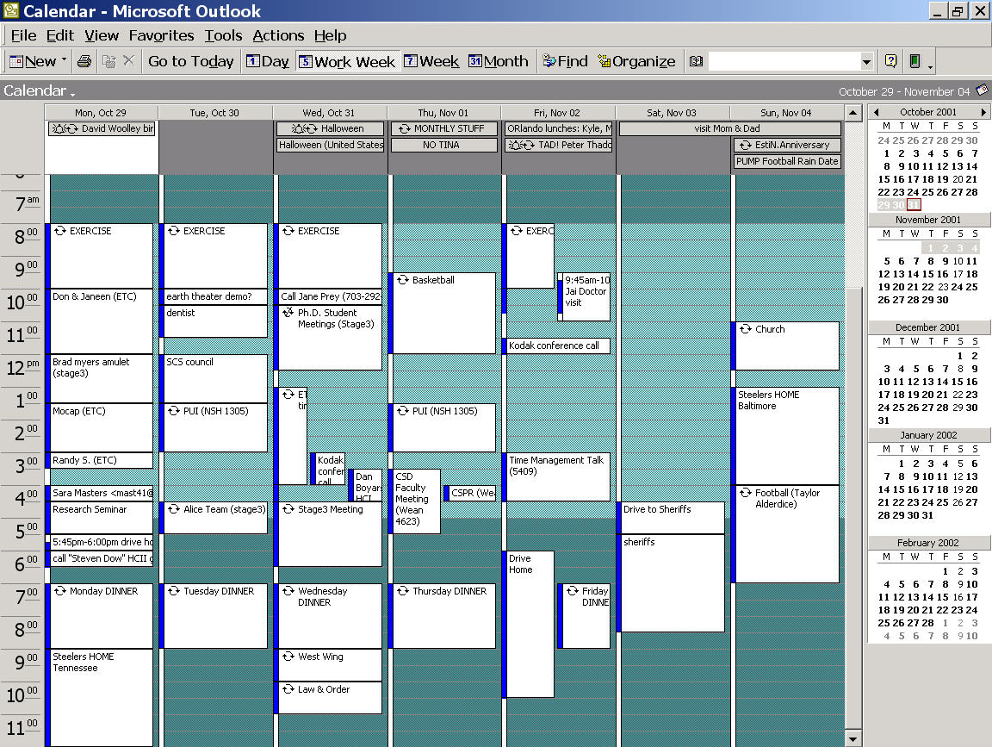

Slide 17
Scheduling Yourself
You don’t find time for important things, you make it
Everything you do is an opportunity cost
Learn to say “No”

Slide 18
Learn to say “No”
Will this help me get tenure?
Will this help me get my masters?
Will this help me get my Ph.D?
Keep “help me” broadly defined

Slide 19
Gentle No’s
“I’ll do it if nobody else steps forward” or “I’ll be your deep fall back,” but you have to keep searching.
Moving parties in grad school…

Slide 20
Everyone has Good and Bad Times
Find your creative/thinking time. Defend it ruthlessly, spend it alone, maybe at home.
Find your dead time. Schedule meetings, phone calls, and mundane stuff during it.

Slide 21
Interruptions
6-9 minutes, 4-5 minute recovery – five interruptions shoots an hour
You must reduce frequency and length of interruptions (turn phone calls into email)
Blurting: save-ups
E-mail noise on new mail is an interruption -> TURN IT OFF!!

Slide 22
Cutting Things Short
“I’m in the middle of something now…”
Start with “I only have 5 minutes” – you can always extend this
Stand up, stroll to the door, complement, thank, shake hands
Clock-watching; on wall behind them

Slide 23
Procrastination
“Procrastination is the thief of time”
Edward Young
Night Thoughts, 1742

Slide 24
Avoiding Procrastination
Doing things at the last minute is much more expensive than just before the last minute
Deadlines are really important: establish them yourself!

Slide 25
Comfort Zones
Identify why you aren’t enthusiastic
Fear of embarrassment
Fear of failure?
Get a spine!

Slide 26
Delegation
No one is an island
You can accomplish a lot more with help
Most delegation in your life is from faculty to graduate student

Slide 27
Delegation is not dumping
Grant authority with responsibility.
Concrete goal, deadline, and consequences.
Treat your people well
Grad students and secretaries are a faculty member’s lifeline; they should be treated well!

Slide 28
Challenge People
People rise to the challenge: You should delegate “until they complain”
Communication Must Be Clear: “Get it in writing” – Judge Wapner
Give objectives, not procedures
Tell the relative importance of this task

Slide 29
Sociology
Beware upward delegation!
Reinforce behavior you want repeated
Ignorance is your friend – I do not know how to run the photocopier or the fax machine

Slide 30
General Advice: Vacations
This works for Email too!
Vacations should be vacations.
It’s not a vacation if you’re reading email
Story of my honeymoon…

Slide 31
General Advice
Kill your television (how badly do you want tenure or your degree?)
Turn money into time – especially important for people with kids or other family commitments
Eat and sleep and exercise. Above all else!

